Slide 1
Machine Learning for data science and business intelligence – 8IAR403
By Kévin Bouchard Ph.D.
Professor in artificial intelligence & machine learning
Laboratoire d'Intelligence Ambiante pour la reconnaissance d'activités (LIARA)
Université du Québec à Chicoutimi
www.Kevin-Bouchard.ca
Kevin_Bouchard@uqac.ca

Slide 2
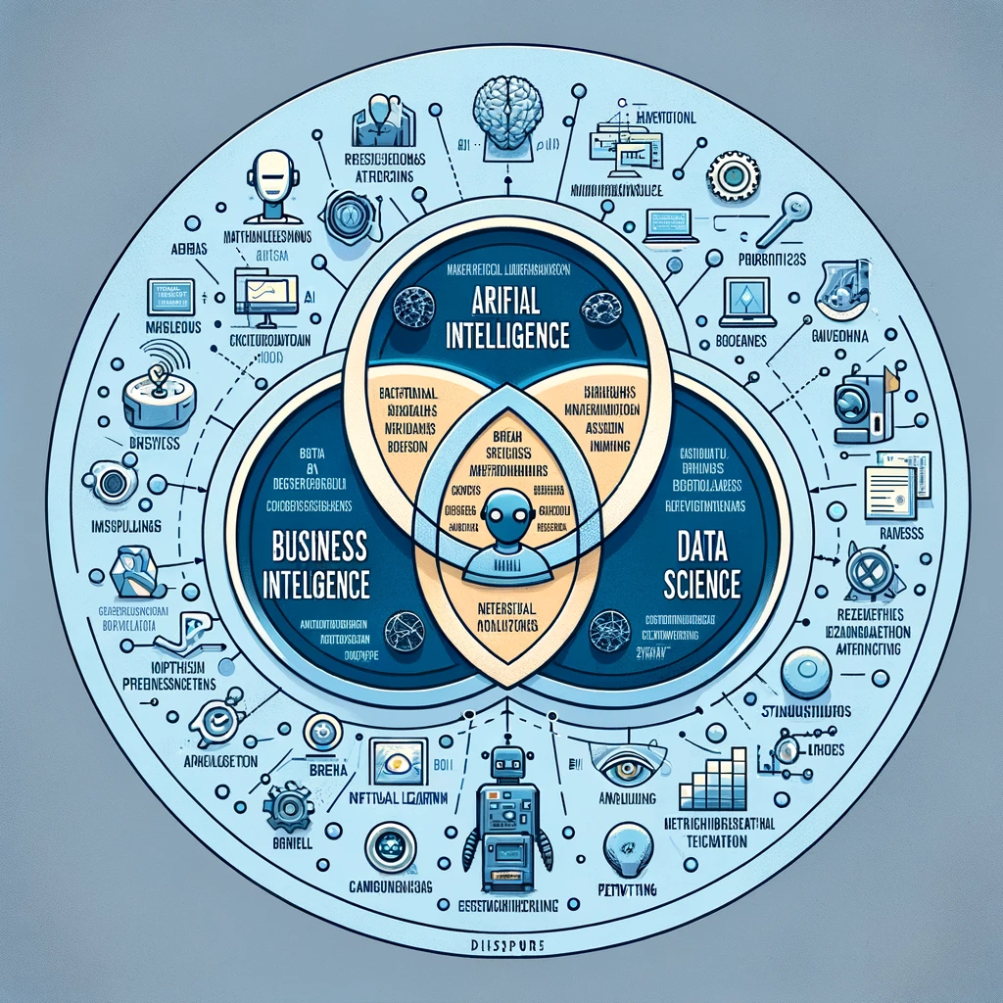
Summary of lesson #2
You will learn about:
The main form machine learning takes
The format data can present itself
How to preprocess and the main steps of a classic machine learning pipeline

Slide 3
Categorizing machine learning
Machine Learning (ML) can be categorized into several types based on the learning approach and the kind of data or feedback available to the learning system
Basically, feedback is how the machine can direct its learning towards a certain objective
Imagine you are cooking a recipe, then feedback could be provided by asking your family about how it taste
Then, you could learn to put less salt in your recipe or something else based on their comments
In machine learning, feedback is generally essential, and cases where none is provided are especially challenging

Slide 4
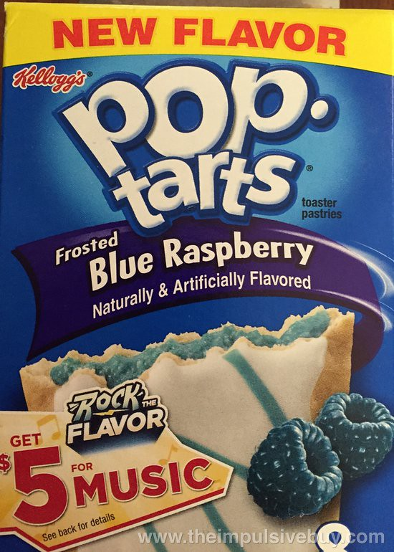
Type of feedback
Supervised learning – X, y
The classic way to approach ML, it involve a labeled dataset X, where each learning instance are associated with a label y
The labels y are the ground truth and provide a feedback for learning
The learning algorithm try to produce a model that associate input instance to output labels
Unsupervised learning – X
A much harder stance on learning, the ML algorithm is not provided with feedback
The goal is to explore the structure of the data to extract meaningful information
We have to be very careful, in Big Data context relations and patterns are bound to emerge, but they may be meaningless
E.g. Clients buy 7x more poptarts when a hurricane is predicted in Florida
E.g. People who eat more cheese are more in debt in France ←spurious correlation
This Photo by Unknown Author is licensed under CC BY-SA

Slide 5
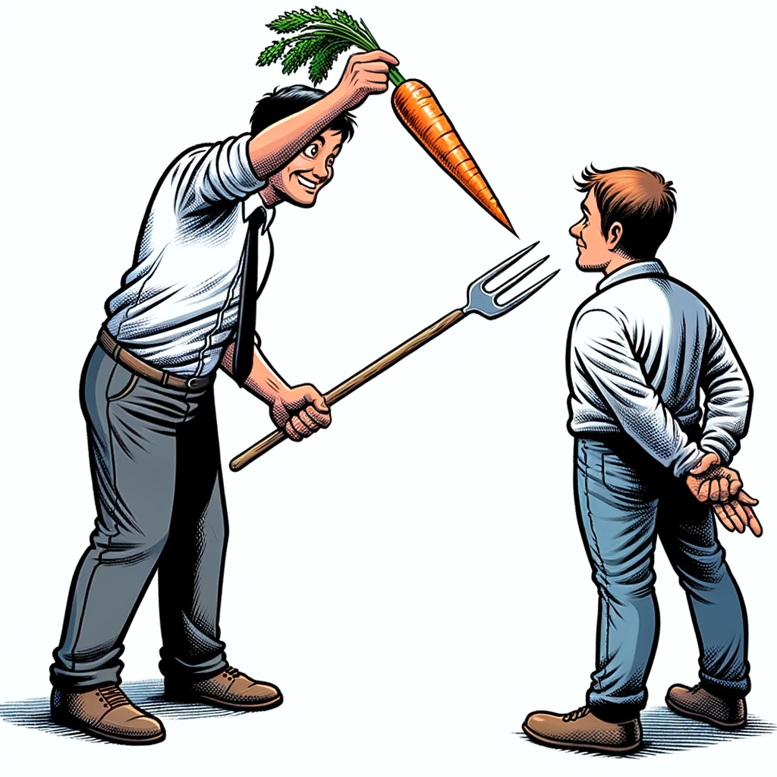
Type of feedback
Reinforcement learning – State/action, reward
In reinforcement learning, an agent learns to behave in an environment by performing actions and seeing the results
It focuses on maximizing a reward signal and is not provided with explicit instructions, but rather must discover which actions yield the most reward by trying them
While it is closely related to supervised learning, it is generally considered more interactive and there are key differences including
An action is chosen in a specific state (semi-randomly)
Reward is dynamically computed using a mathematical function rather a fixed labels
It maximize reward over time rather than trying to predict it
Usually more computationally expensive and requires a simulation

Slide 6
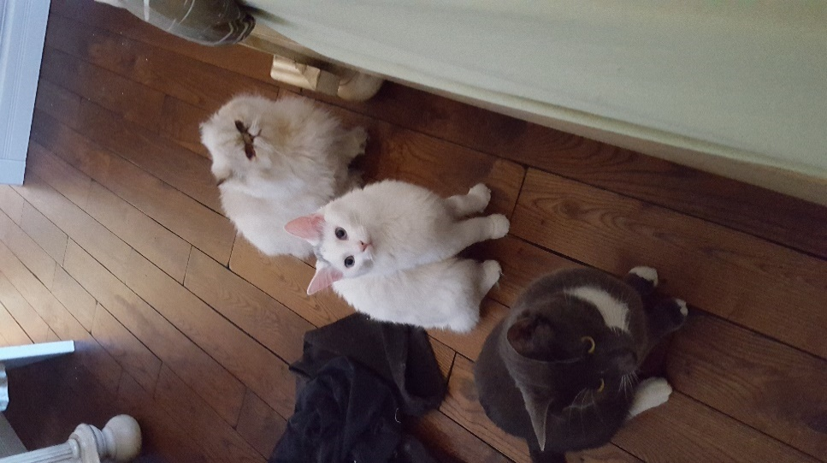
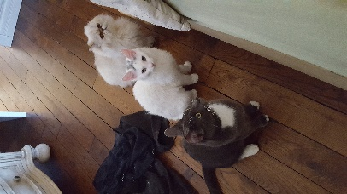
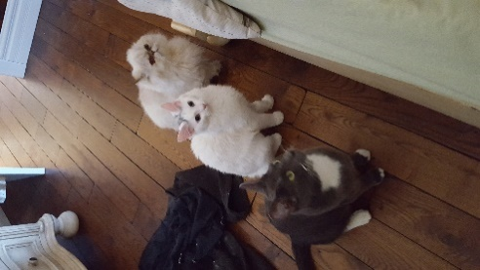
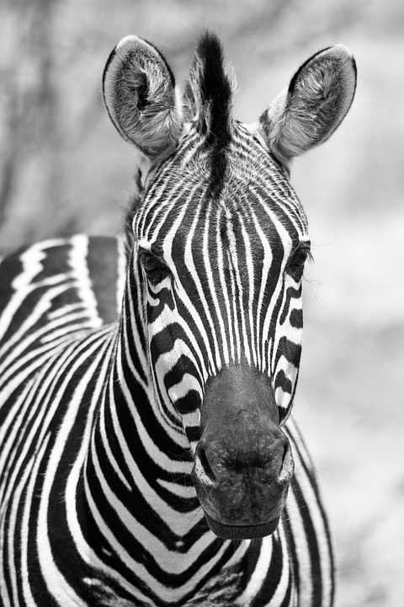
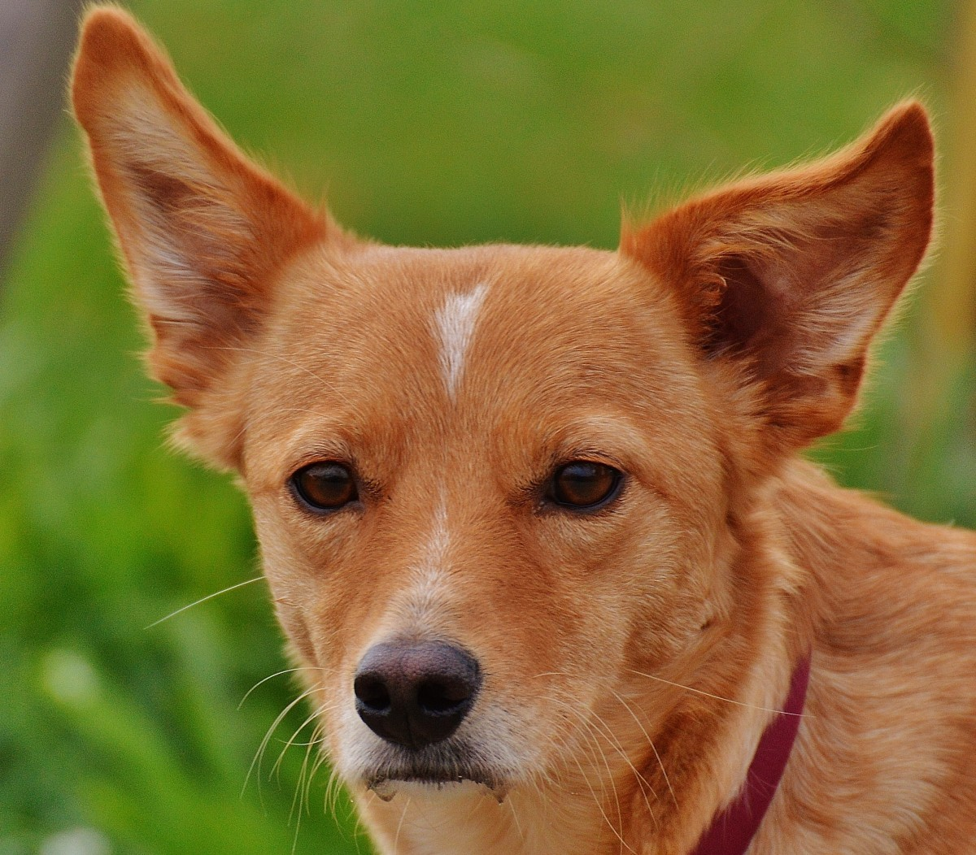
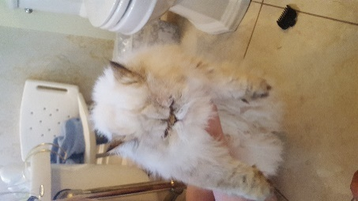
Type of feedback
Semi-supervised – X, partial y
Includes a variety of techniques where it is possible to use partial labeling
Active learning:
It queries a user or a data source to obtain new data points to learn from, which can be especially useful when unlabeled data is abundant but labeling is expensive
Example of this is when an App or a Website ask for feedback to user (Did you like this translation?)
Some learning cats, and non cat
…
Classifier
Not a cat
New data to classify
Cat
Can you tell me if this is a cat?

Slide 7
Type of feedback
Semi-supervised – X, partial y
Transfer learning:
Involve using a pretrained model on a different, but related task
Using this pretrained model, only a small labeled dataset is needed
Group learning
Many disparate techniques that are not de facto standard
Clustering and Label Propagation: The algorithm may group similar data points together (clustering) and then use the known labels of a few data points to infer the labels of entire groups or clusters
Co-Training: If the dataset has different views (sets of features), the algorithm might learn separate classifiers on different views and then use these classifiers to label the unlabeled data. The classifiers improve iteratively as they learn from each other's predictions.
Self-Training: The algorithm first trains on a small set of labeled data, then it uses this trained model to predict labels on the unlabeled data. The most confident predictions are added to the training set, and the model is retrained, repeating the process.

Slide 8
Common tasks of ML
Now that we have described the type of ML according to feedback, let’s have a look on common tasks of machine learning

Slide 9

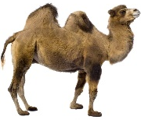
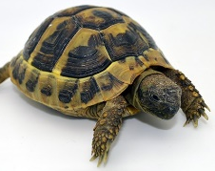
Classification
The most common task is classification
In classification, labels y are discrete values
Example of classification problems includes:
Credit worthiness
Emotion recognition
Speech recognition
Activity recognition
Etc.
?????
Cat
Dog
…
Etc.

Slide 10
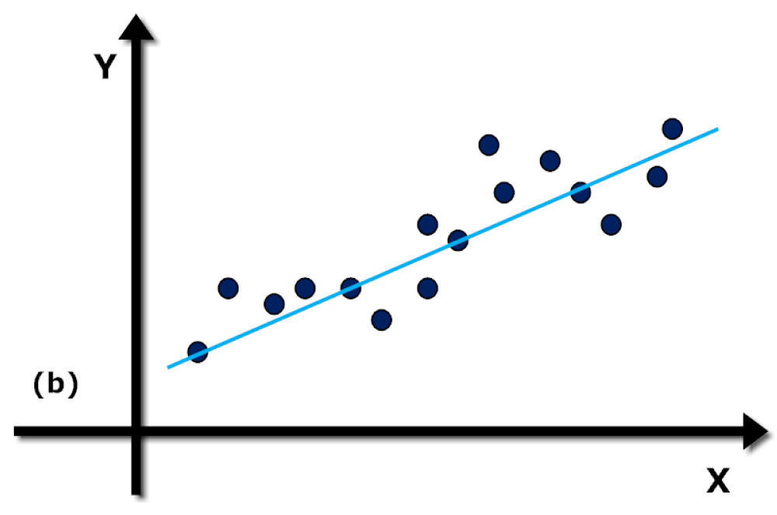
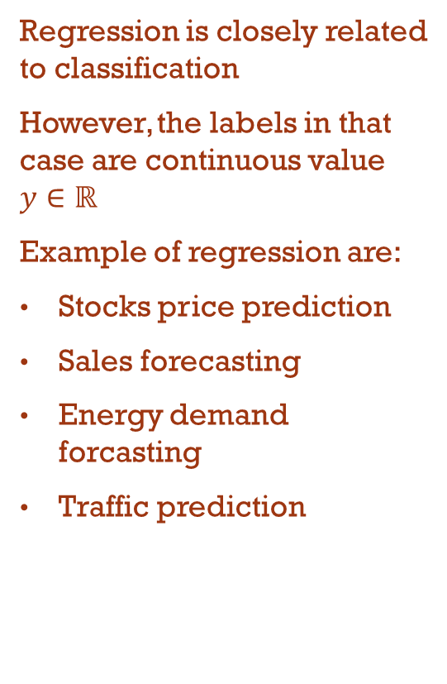

Regression
Regression is closely related to classification
However, the labels in that case are continuous value $y∈ℝ$
Example of regression are:
Stocks price prediction
Sales forecasting
Energy demand forcasting
Traffic prediction

Slide 11



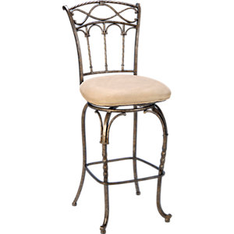


Clustering
Clustering is a type of unsupervised learning in machine learning, where the goal is to group a set of objects in such a way that objects in the same group (called a cluster) are more similar to each other than to those in other clusters
It can be eventually used for unlabeled classification
Example of clustering are:
Market segmentation
Social network analysis
Image segmentation
Anomaly detection
Traffic analysis
Fraud detection
=?

Slide 12
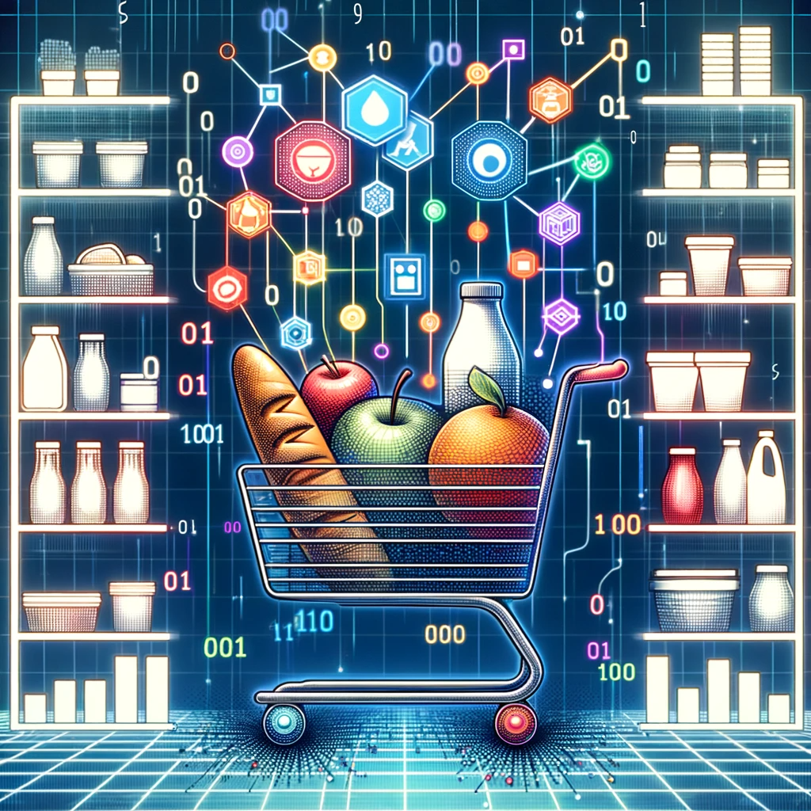
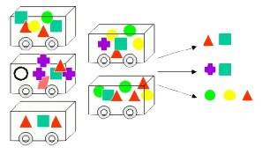
Association rule mining
Association rule mining is a technique in machine learning and data mining for discovering interesting relations between variables in large databases
It's best known for market basket analysis, where it finds sets of products that are frequently bought together
Example of applications are:
Market basket analysis
Cross-Selling and up-selling
Inventory management
This Photo by Unknown Author is licensed under CC BY-SA-NC

Slide 13

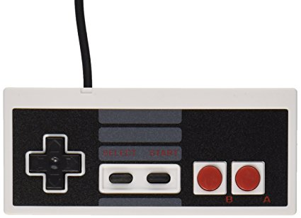

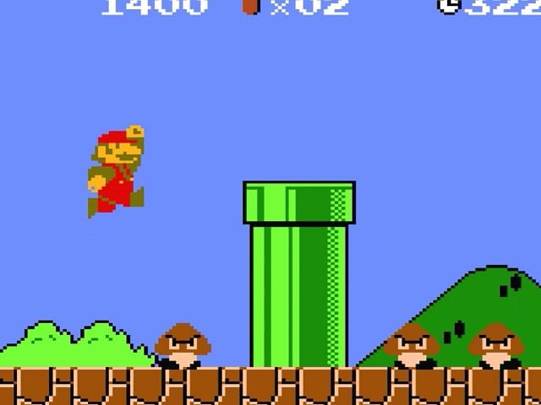

Reinforcement
RL is both a family of approaches and a task of ML
The agent learns from the outcomes of its actions, rather than from being told explicitly what to do
Example of RL tasks are:
Game playing
Robotics
Autonomous vehicles
Adaptive control system
We won’t cover RL in this course since we focus on BI/data science
Acts
Modify the environment
Agent
Reward
Update
Environment
State representation

Slide 14
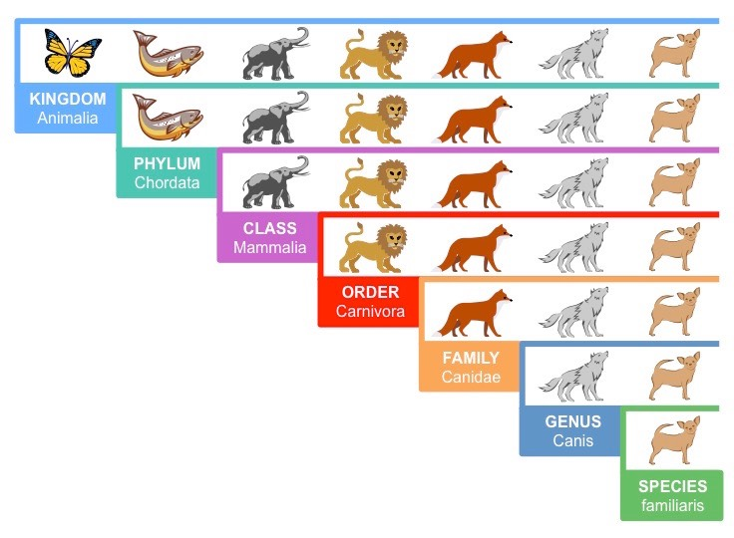
Dimentionality reduction
Dimensionality reduction in machine learning involves reducing the number of input variables in a dataset
This is achieved by creating a set of principal variables, which retain most of the important information from the original dataset, but with a lower dimensionality
The primary goal is to simplify the dataset, reduce the computational complexity, and potentially enhance the performance of machine learning models
Example of tasks are:
Data visualisation
Noise reduction
Feature selection and extraction

Slide 15
Datasets
What is a dataset in machine learning?
How to make sure it is interesting and ready to use?
How does data presents itself in the world?

Slide 16
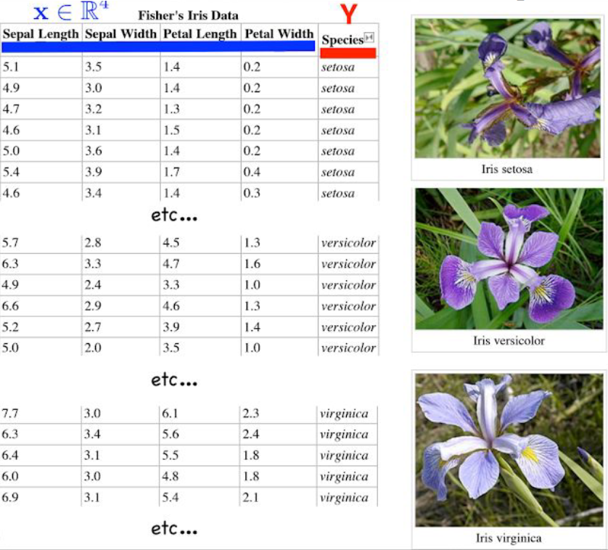
Usual form of data for ML
A database or a structured dataset cannot be directly used for learning!
Instead, we want attribute vectors
We usually need to structure the data as a table where each line is one learning instance
The size of instances must be fixed, so various techniques need to be used if they are variable
Dimentionality reduction
Windowing
Deep learning
Notes:
Voir Exemple #1

Slide 17
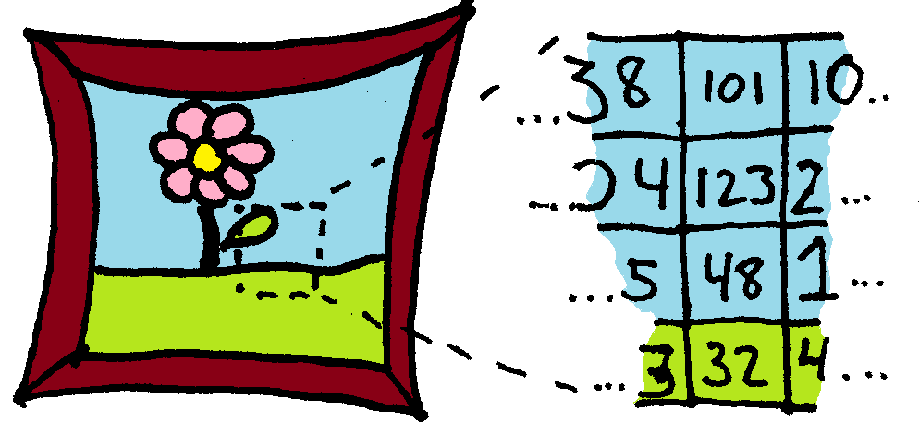
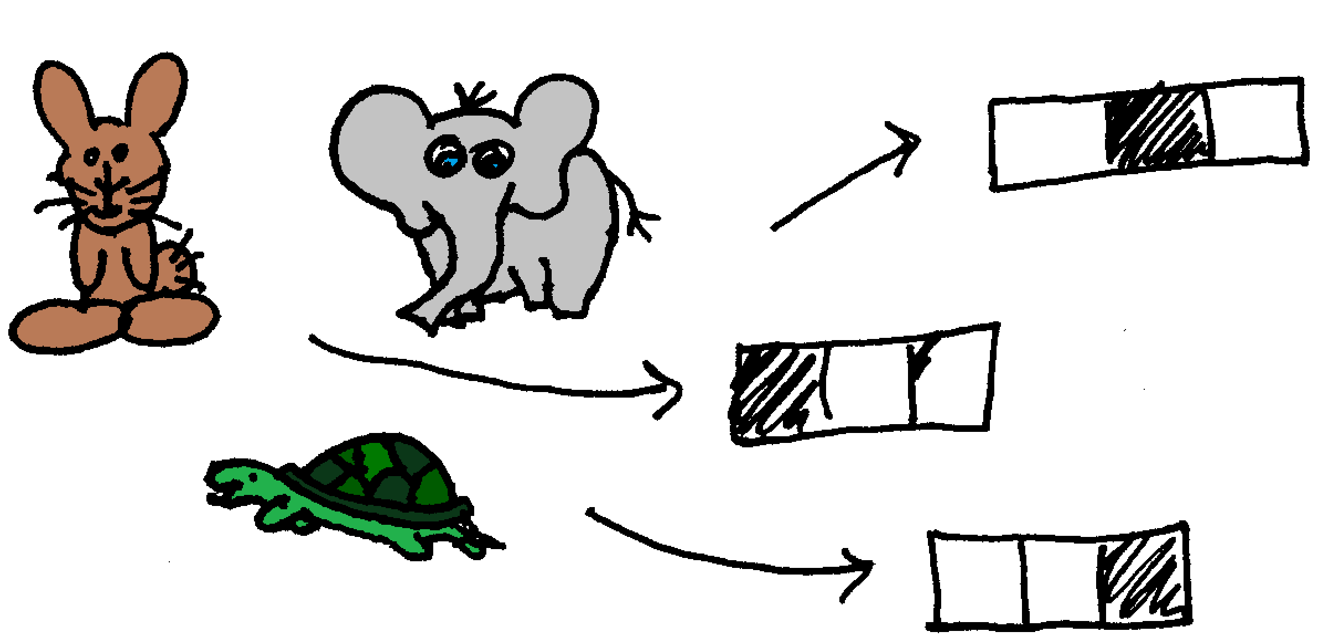
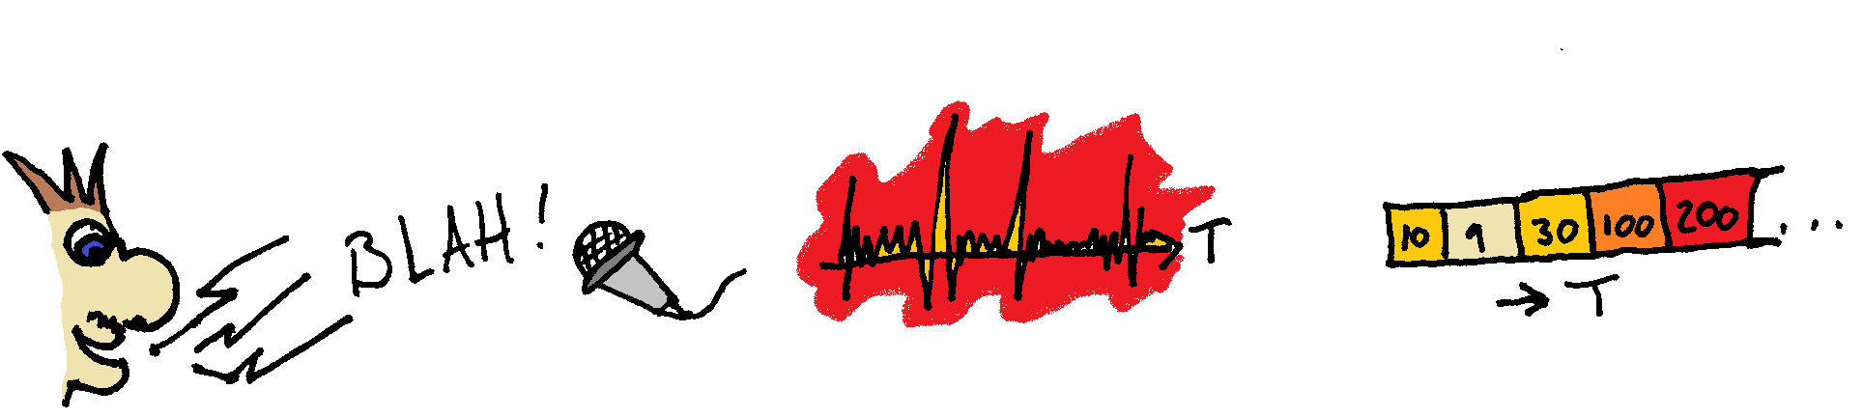
How does it occurs naturally?
Images
Sounds
Categories
Notes:
Just give them a clue about the difficulty, but the possibilities… we’ll talk later about it….

Slide 18
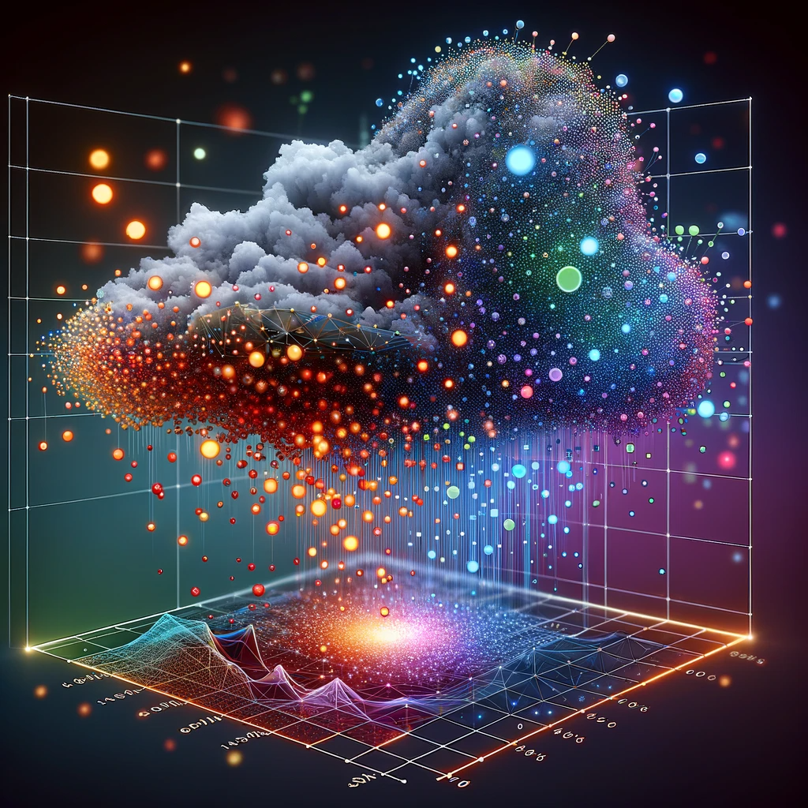
10 000 datasets
622 datasets
Many, many more…
Kaggle -> https://www.kaggle.com/datasets
UCI ML repository https://archive.ics.uci.edu/ml/datasets.php
Datasets from science
https://datasetsearch.research.google.com/
https://pub.towardsai.net/best-datasets-for-machine-learning-data-science-computer-vision-nlp-ai-c9541058cf4f
18
Notes:
Scholar
Researchgate
Etc (Coco, MNIST, etc.)

Slide 19

Data preprocessing
Obviously, most of the time, our data is imperfect and we need to address the problems
You have seen many methods to manipulate data, so this part is mostly a reminder
For instance, you may have missing values that need to be inputed automatically
Notes:
Mélanger nos données (dire que la plupart des méthodes de Scikit s’en charge par défaut!)
Autrement c’est très très important!!!!

Slide 20
Scaling the data
We often talk about scaling because the values are on different ranges of numbers.
For example: Age [0-110], Salary [0-1000000]
Several algorithms are influenced in the creation of their model by the scales of values
K-Means (most clustering in fact)
SVM
Neural net
Others learn much less quickly!
It is the case of neural net that are slower to converge under very unscaled data
Some are almost unaffected such a decision trees, but better be safe than sorry!
20
Notes:
Dire: K-Means, SVM, NN mais d’autres non! ->Decision Tree

Slide 21
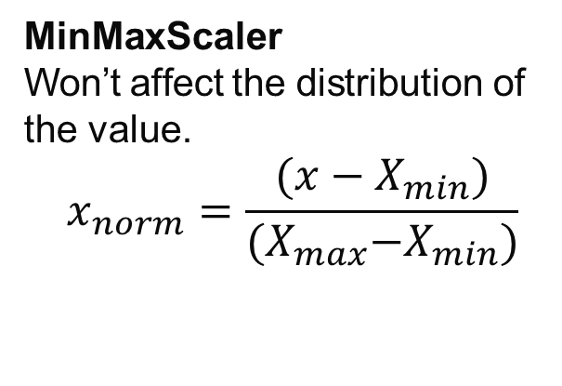
Normalization
Normalization is the scaling of a vector using its norm
In ML, it usually means changing the values so they get comprised between the interval [0,1]
In Scikit-Learn we have these options:
MinMaxScaler
Won’t affect the distribution of the value.
$$x_{norm}=\frac{(x−X_{min})}{{(X}_{max}−X_{min})}$$
MaxAbsScaler
Similar, but with absolute values on the features [-1,1].
Both suffer from extreme outlier data
21
Notes:
Exercice!!!

Slide 22
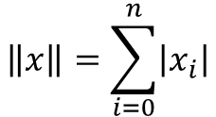

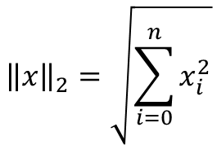
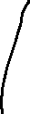
Normalization
preprocessing.normalize(X, norm='l2')
Normalization L1 et L2
Similar, but in terms of vector rather than distinct feature
Aim to obtain a unit norm, but we’ll explain this in more detail in a later class
$$\left\|x\right\|=\sum_{i=0}^{n}{\left|x_{i}\right|}$$
$${\left\|x\right\|}_{2}=\sqrt{\sum_{i=0}^{n}{x_{i}^{2}}}$$
Feature 1
Feature 2
…
Instance1
Warning!
Instance 2
Attention!
Instance 3
…
22

Slide 23
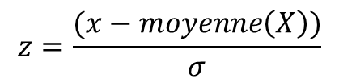
Standardization
Standardization generally mean to scale the values with a mean equal to 0 and a standard deviation of 1
This gives us a standard normal distribution-StandardScaler = Z-Score
$$z=\frac{(x−moyenne\left(X\right))}{σ}$$
Autres options:
RobustScaler
PowerTransformer
Based on percentile, so support marginal outliers
Power transform to the standard distribution
Uniform or Gaussian, using quantile
QuantileTransformer
Notes:
PowerTransformer->techniques avancées pour mapper à une distribution Gaussienne
Quantile->uniform ou Gaussien

Slide 24
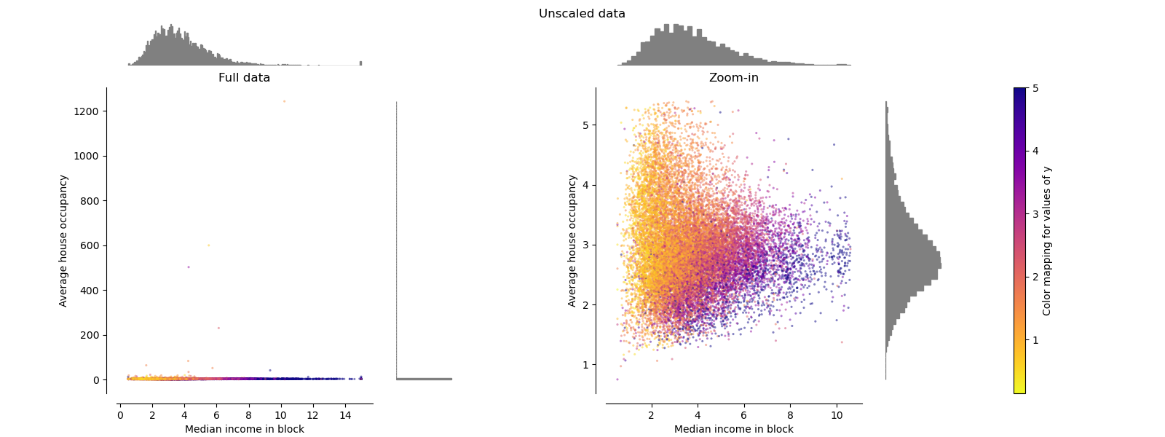
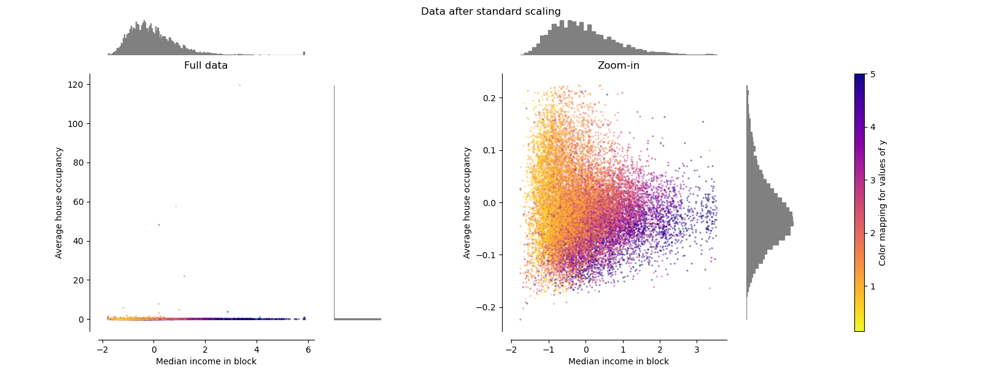
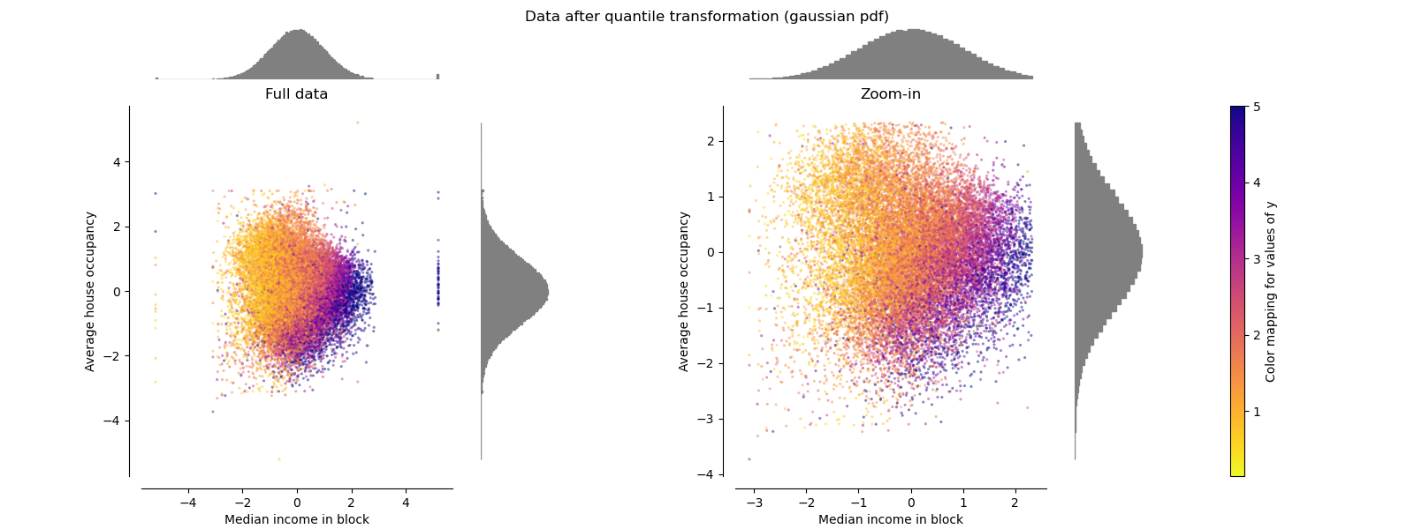
Impact of scaling
https://scikit-learn.org/stable/auto_examples/preprocessing/plot_all_scaling.html
Notes:
Show a bit

Slide 25
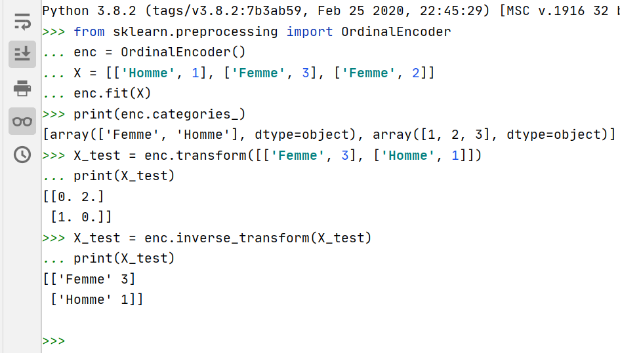
Encoding of nominal data
Since our data can be discrete, we sometime have to transform it
Indeed, most machine learning algorithms cannot handle categorical variables unless they are converted into numerical values

Slide 26
Nominal or ordinal?
OrdinalEncoder induces an order, but not all nominal values are ordinal
An ordinal value is a categorical value for which there is a natural order
The distance between categories is unknown
E.g.: level of education [high school, college, undergraduate, etc.]
Not the case with cities for example [Tianjin, Tokyo, Montreal, New York]
Ideally, it is better to specify it to the encoder:
OrdinalEncoder(categories=['High School', 'College', 'University'])
Notes:
Dire qu’il y a LabelEncoder() ->similaire mais pour les étiquettes et juste 1d…
Choix de matrice ou matrice creuse!

Slide 27
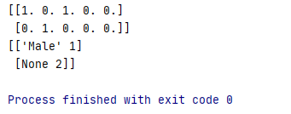
One-hot
from sklearn.preprocessing import OneHotEncoder enc = OneHotEncoder(handle_unknown='ignore') X = [['Male', 1], ['Female', 3], ['Female', 2]] enc.fit(X) enc.categories_ print(enc.transform([['Female', 1], ['Male', 4]]).toarray()) print(enc.inverse_transform([[0, 1, 1, 0, 0], [0, 0, 0, 1, 0]])) enc.get_feature_names(['gender', 'group'])
[ 0 1 0 1 0 0 0 1 0]
LabelBinarizer()
MultiLabelBinarizer()
OneHotEncoder()
27
Notes:
LabelBinarizer() -> pour multiclasse
MultiLabelBinarizer() -> pour multiclasse sur plusieurs éléments

Slide 28
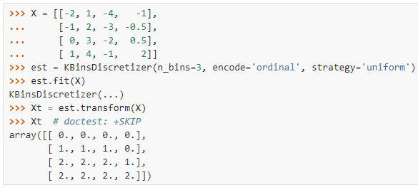
Discretization
Allows the splitting of a continuous variable into a set of finite categories
Can improve the speed of certain algorithms
Allows trees-based methods to perform better
N_bins: number of categories
Encode: Ordinal or one-hot
Strategy:
Uniform: bins of the same size
Quantile: bins with the same number of points
Kmeans: bins whose values share a centroid
Notes:
discretization, binning, quantization

Slide 29
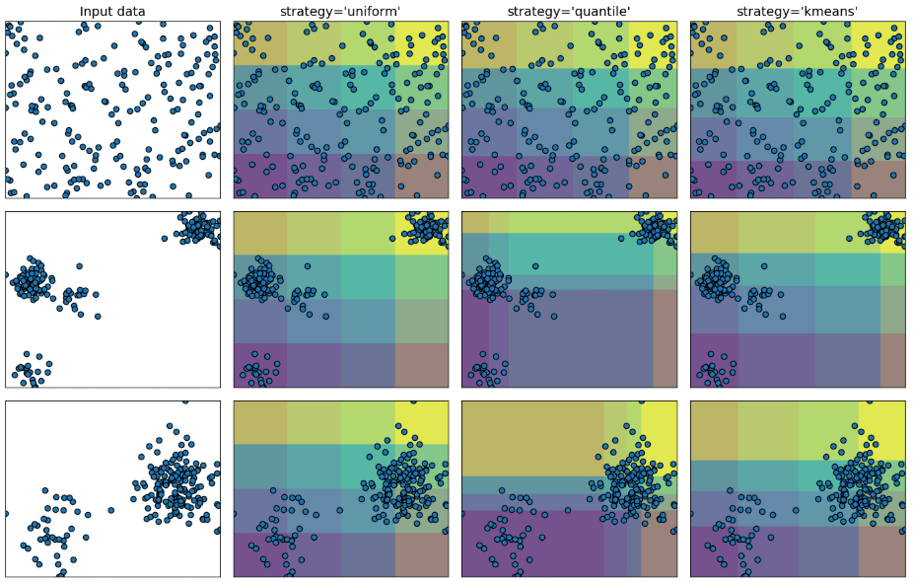
Discretization
From: https://scikit-learn.org/stable/auto_examples/preprocessing/plot_discretization_strategies.html#sphx-glr-auto-examples-preprocessing-plot-discretization-strategies-py

Slide 30
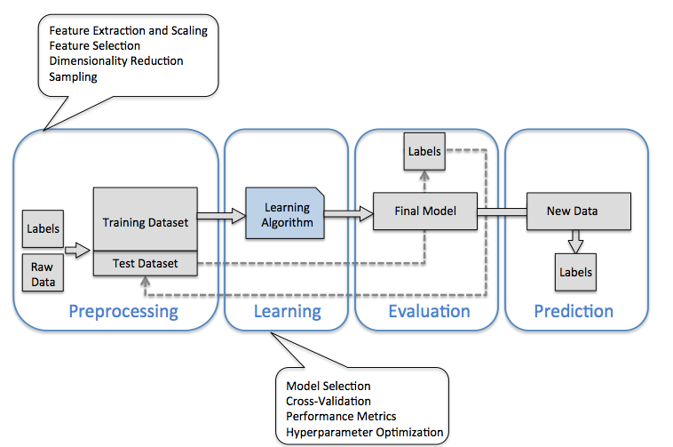
Processus générique du ML

Slide 31

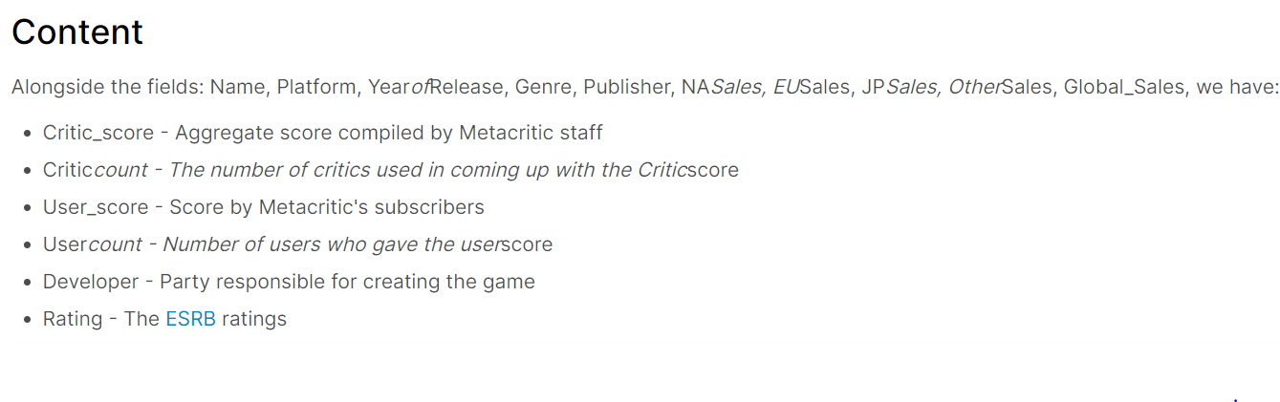
Applied example
Let’s look at how the preprocessing affect a ML pipeline through an example
https://www.kaggle.com/datasets/rush4ratio/video-game-sales-with-ratings

Slide 32
Main References
Russell S., Norvig P., Artificial Intelligence: A Modern Approach. Prentice-Hall, Englewood Cliffs, 2021.
Aggarwal, C. C., Neural networks and deep learning. Springer, 2023.
Goodfellow I., Bengio Y., Deep Learning. The MIT Press, 2016.
Raschka S., Python Machine Learning, Packt Publishing, 2015.
Sutton R.S., Barto A.G., Reinforcement Learning: An Introduction, A Bradford Book, 2021.
Witten I.H., Frank E., Hall M.A., Pal C. Data Mining: Practical Machine Learning Tools and Techniques, Morgan Kaufmann, 2016.

